Slide 1


Doctors of Danbury Computer Security Research Presentation
For security purposes, the name of the company and employee interviewed has been changed. All other details have not been changed.
Andrew Ribeiro
MIS/JLA 341

Slide 2

How this presentation is structured
The information gathered for this presentation was obtained from a current employee of the business in question.
The name of the employee has been omitted and the company name has been changed due to the wishes of the company.

Slide 3
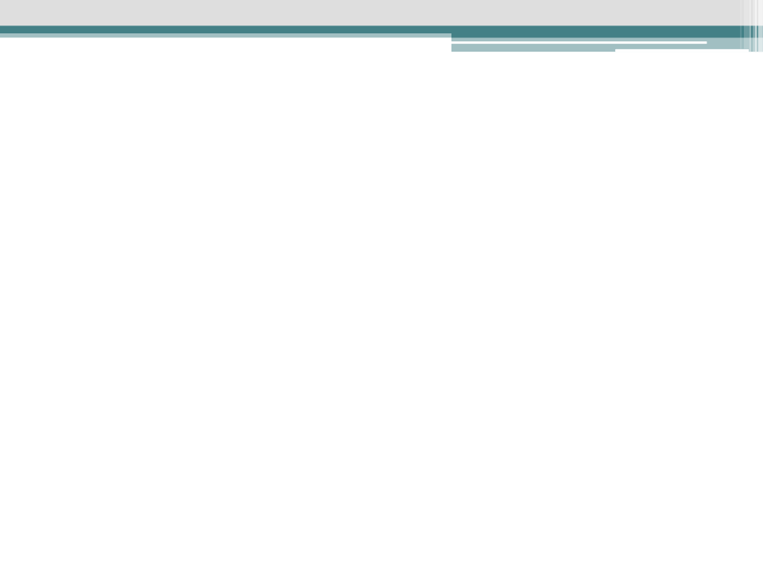



Slide 4
Organizational Information
Company name & location: Doctors of Danbury- Danbury, CT division
Primary purpose of business: Doctors of Danbury’s mission is to provide treatment and diagnosis for medical ailments pertaining to Allergies and Asthma.
Company size:
30 employees
Annual revenue: approximately 1.5 million dollars.

Slide 5
Employee Interviewed
Employee’s job: Office administrator/manager.
Responsibilities of the employee:
Management of the payroll
Vacation coordination/work schedules
Scheduling for the patients and doctors
Close out the computer system
Backup data

Slide 6
Important Business Assets
Patient records– electronic and physical
Computer Systems
Workstations
Servers
RX drugs

Slide 7




HIPAA!

Slide 8
Threats to business assets
Patient records & information
Thievery—confidentiality.
Modification –integrity.
Destruction of records—availability.
Computer Systems
Intrusion—confidentiality.
Malicious code– integrity.
Theft of computer systems ,DOS attacks, or destruction of servers-availability.

Slide 9
Threats to business assets (continued)
RX drugs
Thievery—availability.
Tampering – integrity.

Slide 10
Vulnerabilities
General security vulnerabilities
There are no security cameras.
There is no security personnel.
Not close to any police station.
Alarm system passwords are traded freely.
Half of the employees have keys to the office!
Computer Systems
The areas where the computer systems are located, are not locked during office operation. Although, they are occupied.
No physical controls protect the computer systems during office operation.
Some of the higher up administrators know every ones password.
Patient records & information
The physical patient records are not locked!
The area where calls are taken and patient information is processed is located next to the waiting room which has an opening, allowing patients in the waiting room to hear potential confidential data.

Slide 11
Vulnerabilities (continued)
RX drugs
The storage area of the drugs is locked; however, it is in the middle of a hallway and has glass for a cover. Any one with a hard object– or knee or elbow– can break into the area. Although, since it is in a public spot, it would be hard to pull off in secret.

Slide 12
Consequences of a security breach
If a breach occurs and leads to the theft of patient information because the company has not fulfilled the requirements of Hipaa, they will be penalized severely.
If patient data is stolen they will lose credibility and confidence of patients, which will harm the business.
If the computer systems are stolen or destroyed, the company does not have a DRP in place. This would lead to the company being out of business for quite some time.

Slide 13





Slide 14
Controls
General controls
Alarm systems
Burglary, fire, etc.
Compliant with Hipaa standards
Computer systems
Redundant storage of patient data--on location and off
Data backup daily
Host based IDS, virus protection, and firewalls
Role based access controls
Subscription to a security auditing service

Slide 15
Controls (continued)
Patient records & information
Since most of the records are electronically stored, the controls in place for the computer systems apply here as well.
Data disclosure training– including social engineering.
Physical records must not be left unattended while the office is in operation.
Policies and restrictions– Hipaa related procedures.
Computer systems support Hipaa requirements.

Slide 16
Controls (continued)
RX drugs
The area where the drugs are placed is never left unlocked.
The area where the drugs are placed is in an area where it is constantly watched.

Slide 17


=

Slide 18
My security assessment
Many of the controls Doctors of Danbury have in place are good, and will protect the assets of the business for quite some time. So Doctors of Danbury does put effort into their security practices. However, Doctors of Danbury still has many security vulnerabilities, such as:
Failure to have a disaster recovery plan(DRP)
The culture of the office promotes lax security procedures—such as the sharing of security codes.
The culture of the office supports the thought of a security breach being unlikely– there is a million offices, why would we get attacked?
Some vulnerabilities– as discussed before– have not been solved.
All of these factors above lead me to believe that if a serious security breach takes place, Doctors of Danbury will have a hard time recovering.

Slide 19
Security controls to add
Implement a DRP.
Add physical controls to the computer systems, such as: locks or locked computing areas.
Have a privacy separator between patients and office workers installed.
Create stricter policies involving: passwords, alarm access codes, and keys to the office.
Put the RX drugs and physical patient files in a locked room– add physical controls.

Slide 20

End
Andrew Ribeiro
MIS/JLA 341

